Slide 1
How to utilize 3rd party assessment data in a virtual setting
Andrea Tamarazio, erie 1 boces
November 2020

Slide 2
OUTCOMES
Discuss the different formats of assessment and how they can be used in all settings
What are some best practices that can be utilized in the virtual learning environment
How 3rd Party Assessment data can be utilized in a virtual learning environment

Slide 4
What assessments are being used?
Formative
Summative
Diagnostic / Benchmark
Norm Referenced / Criterion Referenced

Slide 5
What do the assessments tell us?
Formative
Used to provide feedback during instruction
Good for showing growth over time
Summative
Used to sum up learning process at the end of the learning process
Good for assessing mastery and performance levels
Diagnostic
Used to identify current knowledge and / or misconceptions about content
Good for pre/post assessments
Norm & Criterion Referenced
Norm Referenced: compares results with other children of the same age
Criterion Referenced: compares results against a benchmark
Notes:
3rd party assessments can provide a wealth of information. Most teachers call a 3rd Party Assessment a Benchmark Assessment, which is given 3-4 times per year. Teachers need to understand the data that each report from the 3rd party assessment and how it can be utilized more than just 3-4 times per year. Some 3rd party assessment reports will provide information that can be used throughout instruction (these are typically more standards-based reports) while other 3rd party assessments may be norm & criterion referenced and provide information to the teacher that shows how the class compares to other students assessed at the same time

Slide 6
Your thoughts – poll everywhere

Slide 7
How can assessments be used in all settings
Formative
Exit Tickets
Think – Pair – Share activities
Teacher Observation
With virtual settings, these activities can also be utilized. Exit tickets could be presented to students (and staff) surveys, polls, games, etc.
Breakout rooms can be a great resource for teachers to implement engagement strategies that are often used in a typical classroom setting
Notes:
During virtual settings, teacher observation can provide a wealth of information outside of the content being taught. Teachers / Administrators need to be aware of why students may not want to turn on the camera during a class meeting or instructional time.
Teachers can use formative assessment data during data team meetings and discuss how the day to day information compares to 3rd party assessment data

Slide 8
How can assessments be used in all settings
Summative
Performance Task
Quiz / Assessment
Portfolio
With virtual settings, these activities can also be utilized. Quizzes and assessments can be created with an online form or poll anywhere instead of the typical paper-based assessment.
Some websites that may be helpful to create assessments are:
Quizlet
Google (Forms, Peardeck, etc.)
Kahoot
EdPuzzle
Socrative
Notes:
When thinking about 3rd party assessment data, teachers need to utilize the progress monitoring or online toolkits after standards are taught to differentiate instruction for students that need reteaching and students that have already mastered the skills can be assigned more difficult tasks that are available
During data team meetings, teachers need to analyze the 3rd party assessment data and discuss how the students are performing on class quizzes, etc. Teachers need to also think about the levels of questioning asked and how that impacts results

Slide 9
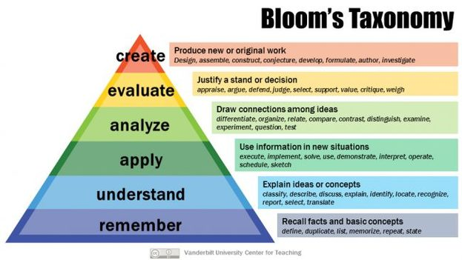
Bloom’s Taxonomy
When creating assessments, teachers and administrators need to keep the various levels of hierarchy in mind
Notes:
For virtual assessments, teachers need to do more than just multiple-choice questions. Most 3rd party assessment data is around the remember and understand categories of Bloom’s Taxonomy however teachers need to use a variety of questioning to ensure students cannot copy answers from the internet. When teachers are meeting during data teams, discussions about the format of questions and how students are performing on MC questions vs short answer questions.

Slide 10
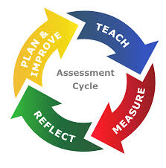
Assessments in a virtual setting
Web Based
Data Collection
Progress Monitoring
Standards / Skills Alignment
Notes:
Mos assessments from a 3rd party are web based and easy to administer in a virtual setting.

Slide 11
Examples of diagnostic / Benchmark Assessments
Running Records
Word Lists
Reading Inventory (Phonics, Reading Comprehension, Vocabulary)
Math Inventory (Number & Operations, Math Facts, Math Applications, Measurement, Geometry, Algebra skills)
Notes:
Typically used Benchmark or Diagnostic assessments are :
AIMSweb
iReady
NWEA
STAR

Slide 12
Running records in a virtual setting
Create a schedule
Multiple copies of passages
Create a google slide
Reading A-Z passages
Record the passage reading
Provide immediate feedback
Keep a data notebook
Excel, form, etc.
Notes:
Teachers can share their screen, record the student reading and then determine the student’s reading level.
Evernote can be used to assist in administering virtual running records

Slide 13
What data do we learn from running records & how to apply it in a virtual classroom
Reading level
Score for word reading accuracy
Analysis of errors & self corrections
Comprehension
Patterns
Individual concern vs class concern
Gaps in instruction
Student Grouping
AIS instruction
Notes:
Can conduct running records during reading groups by using the passages / leveled reading books
Assign tasks to students that help with errors and self correction strategies
Online programs can be utilized to differentiate instruction
Discuss Letter ID / Letter Sounds as well as sight words – all are interconnected and the data that is gathered from one assessment can provide information to a teacher / parent / administrator to help achieve student success

Slide 14
3rd Party Assessment Data
Measure essential knowledge and skills as efficiently as possible
Provides student and classroom profiles of strengths and weaknesses to tailor instruction to the needs of all students
Can be aligned to state standards and curriculum alignment
Usually aligned with reading and math skills
Can identity those at-risk students
Norm or Criterion Referenced
Notes:
Most are computer adaptive
Short period of time

Slide 15
Reading Data with 3rd Party assessments
Reading Data
Phonological Awareness
Phonics
High Frequency Words
Vocabulary
Reading Comprehension
Reading Fluency
Notes:
This data can be presented as a scale score, percentile rank, show student growth over time
Discuss ways to utilize the data on this slide

Slide 16
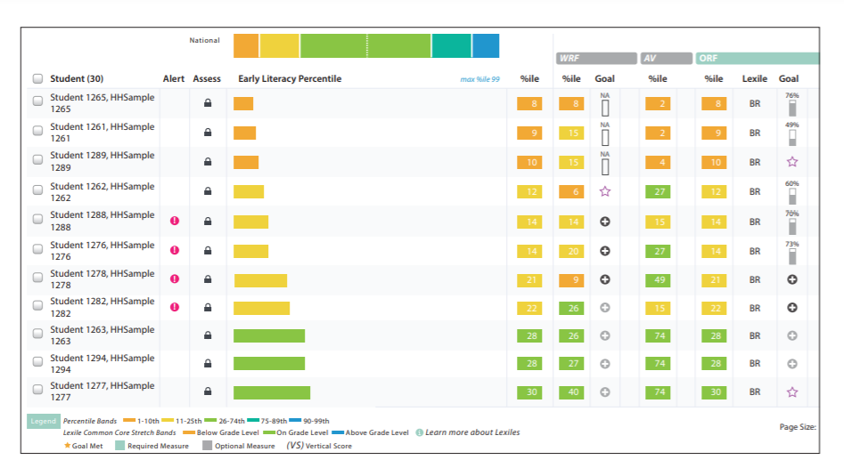
Reading report samples
Notes:
This data can be presented as a scale score, percentile rank, show student growth over time
Discuss ways to utilize the data on this slide in a virtual setting

Slide 17
Math data with 3rd party assessments
Fact fluency
Math comprehension
Skills
Numbers & Operations
Algebra
Geometry
Measurement & Data

Slide 18
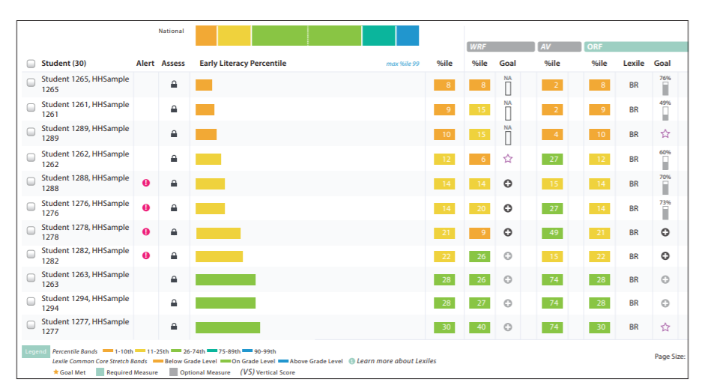
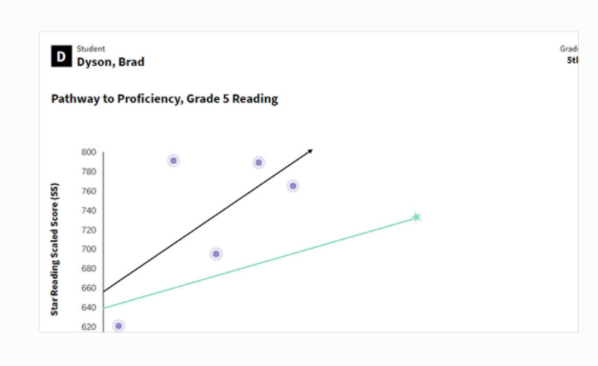
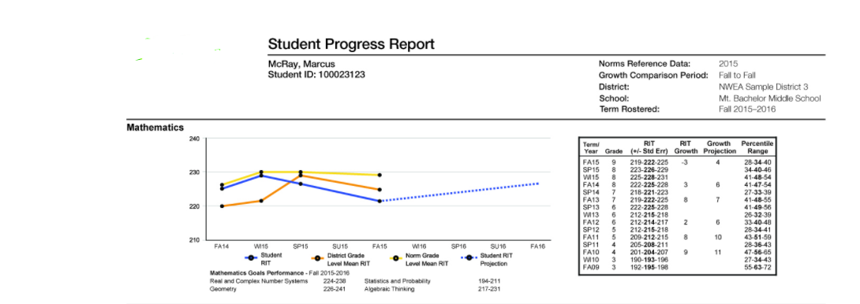
Sample math reports
Notes:
This data can be presented as a scale score, percentile rank, show student growth over time
Discuss ways to utilize the data on this slide in a virtual setting

Slide 20
Notes:
Discuss data meeting ideas and conversations to lead

Slide 21
Notes:
Allow time for questions and discussion

Slide 22
Contact information
Andrea Tamarazio
Erie 1 BOCES
atamarazio@e1b.org

